Slide 1


Autonomous Lane following and tracking of RC car
B.M.S COLLEGE OF ENGINEERING
Bull Temple Road, Basavanagudi, Bangalore - 560 019, Karnataka, India
Mohammed Salman 1BM14EC049 Krishna Sai Tarun - 1BM14EC046 Kushal N - 1BM14EC047
Nikhilesh -1BM14EC062
Under the guidance of
Bhavana H T
Academic Intern
Project for Community Service
2017 – 18
Department of Electronics and Communication Engineering

Slide 2
Introduction
Autonomous: aw-ton-uh-muh s without need for human control or intervention.
Demand for Autonomous system has increased in recent times.
From Industry to our Homes are being automated

Slide 3
Scope of project
SAFETY Driverless cars will allow significant decrease in accidents caused by driver’s error. For example: 78% road accidents are driver’s fault in India (Source: TOI)
TRAFFIC Commuters waste a FULL WEEK in traffic each year, a monumental waste of time, energy and human potential.

Slide 4
Problem definition
Implementation of Autonomous cars is highly difficult and the cost is very high. So, Mimicking of Self-driving car is carried out.
The main objectives of our project are as follows:
Streaming continuous data of lane using Pi camera and Raspberry Pi.
Use python and open CV libraries to create an self-driving module using collected data.
Modify a RC car to self-drive on a given lane.
Track the location of the RC car.

Slide 5
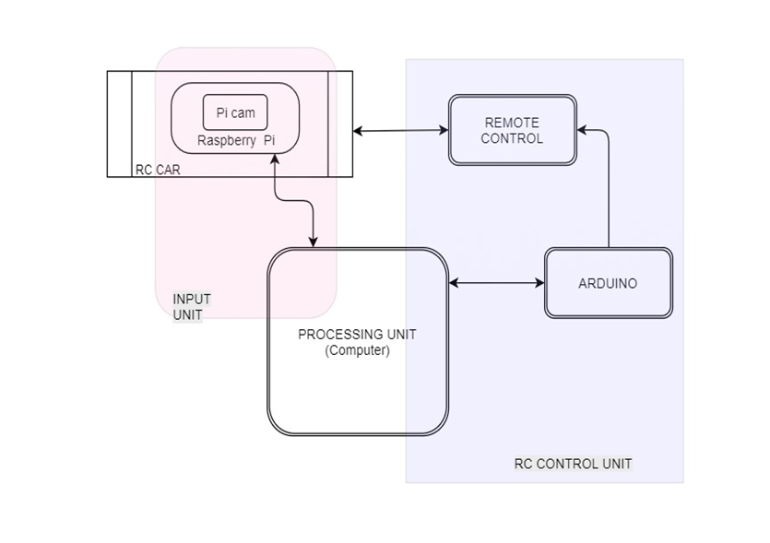
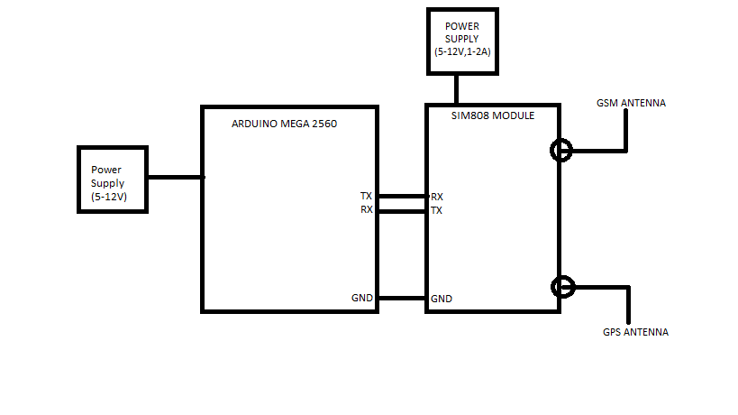
PROPOSED SOLUTION
The system consists of three subsystems: input unit (Pi camera), processing unit (Raspberry PI & computer) and RC car control unit.

Slide 6
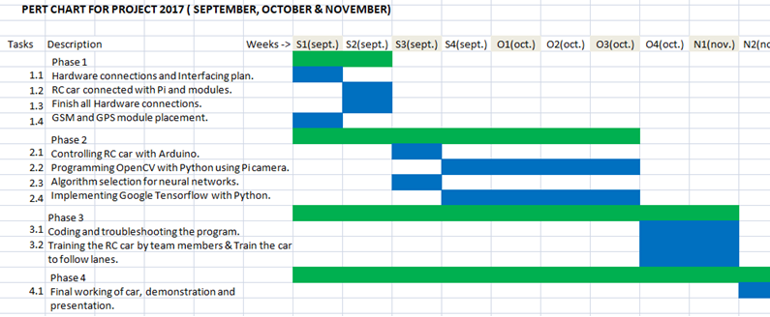
Project planning

Slide 7
Machine Learning Implementation
Machine Learning (ML) implements feed-forward artificial neural networks or, more particularly, multi-layer perceptrons (MLP), the most commonly used type of neural networks.
A multilayer perceptron (MLP) is a class of feedforward artificial neural network. An MLP consists of at least three layers of nodes. Except for the input nodes, each node is a neuron that uses a nonlinear activation function. MLP utilizes a supervised learning technique called backpropagation for training.
Multilayer perceptrons are sometimes colloquially referred to as "vanilla" neural networks, especially when they have a single hidden layer.

Slide 8
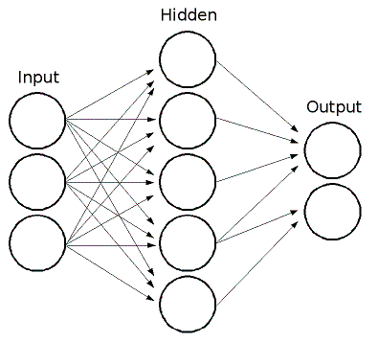
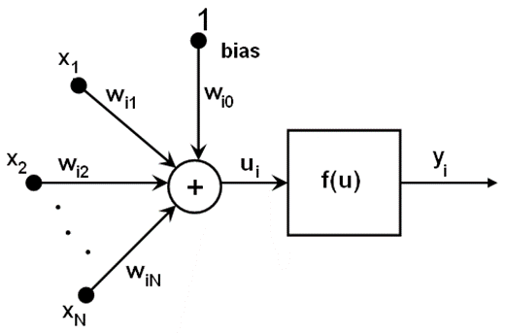
MLP consists of the input layer, output layer, and one or more hidden layers. Each layer of MLP includes one or more neurons directionally linked with the neurons from the previous and the next layer. The example below represents a 3-layer perceptron with three inputs, two outputs, and the hidden layer including five neurons.
The values retrieved from the previous layer are summed up with certain weights, individual for each neuron, plus the bias term. The sum is transformed using the activation function f(u) that may be also different for different neurons.

Slide 9
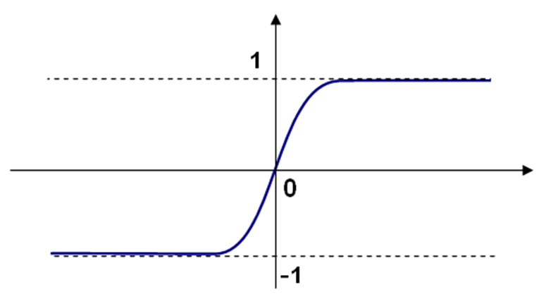
Activation Function
Activation Function used here is a symmetrical sigmoid function. A sigmoid function is a mathematical function having a characteristic "S"-shaped curve or sigmoid curve. Often, sigmoid function refers to the special case of the logistic function shown in the first figure and defined by the formula

Slide 10
Back Propagation Algoritm
Phase 1: propagation
Each propagation involves the following steps:
Propagation forward through the network to generate the output value(s)
Calculation of the cost (error term)
Propagation of the output activations back through the network using the training pattern target in order to generate the deltas (the difference between the targeted and actual output values) of all output and hidden neurons.
Phase 2: weight update
For each weight, the following steps must be followed:
The weight's output delta and input activation are multiplied to find the gradient of the weight.
A ratio (percentage) of the weight's gradient is subtracted from the weight.
This ratio (percentage) influences the speed and quality of learning; it is called the learning rate. The greater the ratio, the faster the neuron trains, but the lower the ratio, the more accurate the training is.

Slide 11
Estimated budget:
ESTIMATED BILL
DESCRIPTION PRICE(INR)
Raspberry Pi = 3,500
Pi camera = 2,500
64GB MicroSD card =1,600
RC Car = 1,400
GSM & GPS module = 2,000
Arduino UNO = 400
Power bank = 1,200
Bread board & jumper wires = 500
-----------------------------------------------
Total bill ~ 13,100

Slide 12
Reference details
Links for understanding the need of the project
https://www.ted.com/talks/wanis_kabbaj_what_a_driverless_world_could_look_like
https://www.ted.com/talks/chris_urmson_how_a_driverless_car_sees_the_road
http://www.autoexpress.co.uk/car-tech/85183/driverless-cars-everything-you-need-to-know-about-autonomous-vehicles
Links for proposing solutions
http://www.kdnuggets.com/2017/06/machine-learning-algorithms-used-self-driving-cars.html
Vicente Milanes, Enrique Onieva, Joshue Perez Rastelli, Jorge Godoy, Jorge Villagra. An Approach to Driverless Vehicles in Highways. 14th International IEEE Conference on Intelligent Transportation Systems, Oct 2011, Washington, United States. 2011. (Paper)
https://hal.inria.fr/hal-00737663/document
Estimated budget = Rs 14,500

Slide 13
Thank you

